Slide 1

Introduction to Software Testing
Software testing is a critical phase in the Software Development Life Cycle (SDLC) that ensures software works as expected and is bug-free. It's vital for preventing costly failures and enhancing user satisfaction.

Slide 2
What is Software Testing?
Verifying Functionality
Detecting Defects
Meeting Requirements
The core purpose is to verify and validate that software functions as intended and meets all specified requirements.
It systematically detects and identifies defects, bugs, or errors before the software is released to end-users, minimizing post-release issues.
Ensures the final product aligns with both technical specifications and the actual needs and expectations of the users.

Slide 3
Verification vs. Validation
Verification: Building it Right
Validation: Building the Right Product
Verification focuses on whether the software is built according to specifications and design documents. It answers the question: "Are we building the product right?"
Validation ensures the software meets the actual user needs and business requirements. It answers the question: "Are we building the right product?"
Static analysis
Usability testing
Code reviews
User acceptance testing (UAT)
Inspections and walkthroughs
Beta testing
Both verification and validation are indispensable for comprehensive quality assurance in software development.

Slide 4




Types of Software Testing
Manual Testing
Automation Testing
Human-driven, exploratory, and functional checks to identify bugs without automation tools.
Scripted tests for repetitive tasks, regression testing, and efficient execution using automated tools.
Functional Testing
Non-Functional Testing
Verifies that each function of the software operates according to the requirements specification.
Assesses system performance, security, usability, reliability, and other non-functional attributes.

Slide 5
Levels of Software Testing
Acceptance Testing
1
Final validation by end-users or clients to ensure the software meets business needs.
System Testing
2
End-to-end testing of the complete integrated system to verify overall functionality.
Integration Testing
3
Testing combined modules or components to expose interface defects and interactions.
Unit Testing
4
Testing individual components or modules in isolation to ensure they function correctly.
These levels form a hierarchy, progressing from isolated components to the entire integrated system.

Slide 6














Software Testing Life Cycle (STLC)
Test Planning
Requirement Analysis
Create the test plan, defining strategy, objectives, and resources.
Understand and analyze software requirements to define test scope.
Test Design
Develop detailed test cases, scripts, and test data.
Test Closure
Complete testing activities, prepare reports, and sign off.
Environment Setup
Prepare the necessary hardware and software environment for testing.
Defect Tracking
Test Execution
Report, track, and manage defects until resolution.
Run test cases, log results, and identify defects.
The STLC ensures a structured and systematic approach to testing, enhancing efficiency and quality.

Slide 7
Testing Methodologies
Waterfall Testing
Agile Testing
DevOps Testing
A sequential, phase-based approach where testing begins after the development phase is complete.
An iterative and continuous testing methodology, deeply integrated with development in short cycles.
Emphasizes automated, continuous integration and delivery pipelines, fostering collaboration and speed.

Slide 8
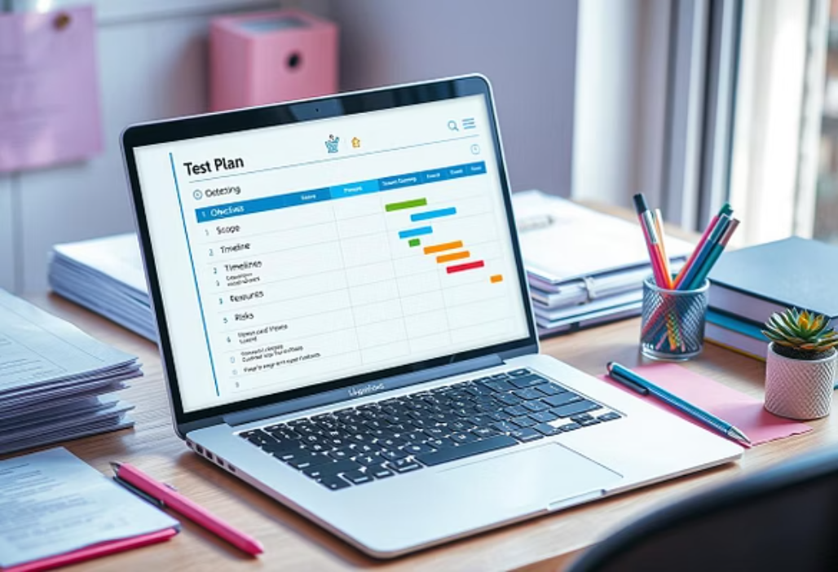

Test Planning and Execution
Test Planning
Test Execution
Defines scope, objectives, and strategy
Running manual or automated tests
Allocates resources and sets timelines
Recording results and observations
Identifies entry and exit criteria
Logging defects with detailed information
Well-defined test plans and meticulous execution are vital for effective software quality assurance.

Slide 9



Tools and Reporting
Test Management Tools
Automation Tools
Reporting & Analysis
Platforms like TestRail and Jira for efficient test case management and defect tracking.
Tools such as Selenium and TestGrid for automating UI, API, and regression tests.
Generating clear defect reports and test status updates for stakeholders.
These tools streamline the testing process and provide transparent insights into software quality.

Slide 10
Benefits of Software Testing & Summary
Reduced Costs & Risks
Enhanced Quality & Reliability
Early bug detection significantly lowers development costs and mitigates potential risks.
Improves software quality, reliability, and overall performance, leading to greater user trust.
Secure & High-Performing Apps
Integrated Development
Essential for delivering robust, secure, and high-performing applications in today's digital landscape.
Seamless integration throughout the SDLC ensures better products and a smoother release cycle.
Software testing is not merely a phase, but a continuous commitment to excellence in software delivery.

